Slide 1
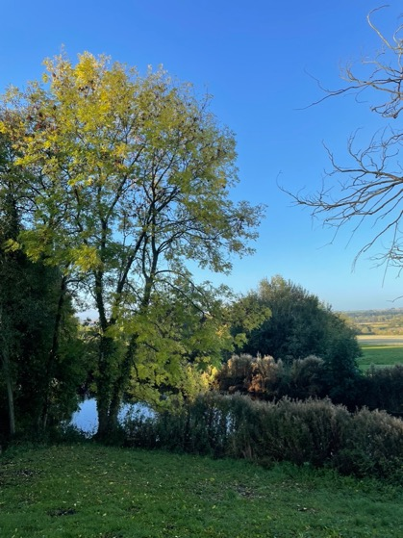
oneill homer
The role Neighbourhood Plans can play in climate change mitigation

Slide 2
Neighbourhood planning and climate change
Neighbourhood Plans have become one of the most important initiatives of town and parish councils over the last decade and communities are increasingly interested in their plans seeking to embrace local policies and actions including, for example:
  Identifying green infrastructure networks for protection, improvement and connectivity enhancement
  Identifying sustainable travel networks and ‘20 minute neighbourhood’-type concepts
  Raising the standards of energy performance through building fabric design
  Shaping the future of their communities to become more resilient and self-dependent by planning for sustainable development.
  We have helped nearly 200 communities to deliver sustainable development through neighbourhood plan-making, including 50+ in Bucks and MK.
oneill homer #PlanningForGood

Slide 3

Green infrastructure (GI)
“A network of multi-functional green space, urban and rural, which is capable of delivering a wide range of environmental and quality of life benefits for local communities.” NPPF
We work with local communities to define their network of green and water infrastructure assets for protection, improvement and creation.
We encourage communities to identify specific aspects of their GI network (e.g. hedgerows, significant areas of mature trees) which can then be built into a policy map.
As a result, all future development proposals must recognise the GI network and improve it, or at the very least not undermine its integrity of connecting spaces and habitats.
Biodiversity Net Gain (BNG) sites can also be designated as a method of offsetting the impact of developments.
oneill homer #PlanningForGood

Slide 4
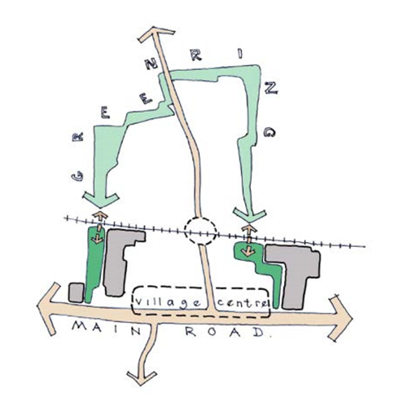
Southbourne Neighbourhood plan
The plan faced three challenges:
  1. Severance issues
  2. Chichester & Langstone Harbours SPA
  3. Speculative Planning Applications
To meet these challenges, a clear spatial framework was formulated. At its heart is the ‘Green Ring’, which provides a stronger village identity, ecological enhancements, a range of new recreation spaces for the community and adaptation to climate change.
oneill homer #PlanningForGood

Slide 5
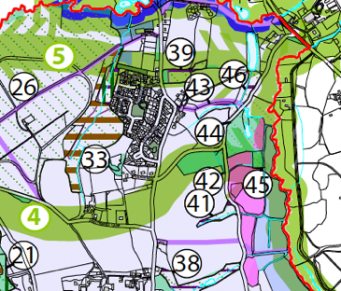
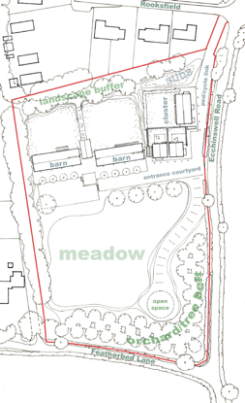
Ecchinswell neighbourhood plan
Ecchinswell identified a series of wildlife corridors as part of its GI Network. One of the sites it intended to allocate fell within one of the wildlife corridors identified in the policy map.
The location of the site within the GI network and wildlife corridor shaped the development response (shown in red on the figure to the right). Benefitted from the Hants Biodiversity Records Centre data – not yet matched in Bucks/MK area.
oneill homer #PlanningForGood

Slide 6
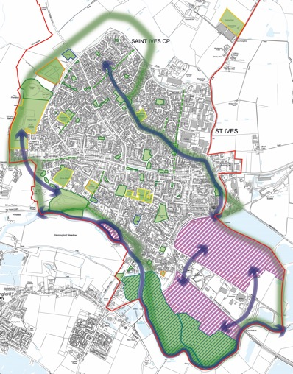
St ives (cambs) neighbourhood plan
The project steering group is combining many of these same ideas to shape green infrastructure planning within and on the town’s edges. It’s thinking especially about improving habitat connectivity and opportunities for local nature recovery, establishing important markers for future development proposals.
oneill homer #PlanningForGood

Slide 7
Sustainable transport solutions
A local community can also identify their sustainable transport network for new developments to respond to.
The network can include any routes or paths that promote active travel (walking, cycling, etc), as well as public transport.
This may mean that scheme layouts, access points, landscape schemes and amenity spaces are designed to contribute to the effectiveness of the Network and without undermining other policy objectives.
The promotion of sustainable transport networks can help address the car-dependency issue faced by places such as Milton Keynes.
oneill homer #PlanningForGood

Slide 8
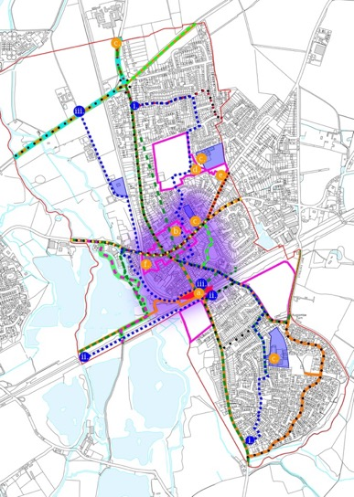
Twyford neighbourhood plan
The purpose of Twyford including a sustainable transport policy in their Neighbourhood Plan was to promote more walking, cycling and use of public transport.
The policies map shows the location of opportunities for improvement to existing routes which have a spatial consequence, such as opportunities for new connections to enhance the active and sustainable transport environment.
oneill homer #PlanningForGood

Slide 9
Sustainable design
Aside from ensuring sustainable patterns of land uses in settlements, policies can be used to minimise the energy demand of buildings, to store carbon and to generate renewable energy.
“It seems to me folly to build new houses now that will commit owners to potentially expensive and disruptive alterations as the UK moves to decarbonise heating of its housing stock”.
PINS Inspector Brian Cook BA( Hons) DIPTP MRTPI
APP/K1128/W/20/3252623
oneill homer #PlanningForGood

Slide 10
The ivers neighbourhood plan etc etc …
There is a significant weight of evidence that buildings rarely live up to their designers’ expectations when completed and occupied and depart significantly from the standards against which they were certified at design stage. This is known as the ‘performance gap’ and is a widely acknowledged problem. The risk of identifying building performance gaps between forecast and actual performance using conventional building construction methods is high.
The Ivers Neighbourhood Plan has been successful at examination in encouraging and incentivising the PassivHaus or equivalent standard. Where applicants are not proposing to meet these standards, a Post Occupancy Evaluation report will be required.
oneill homer #PlanningForGood

Slide 11
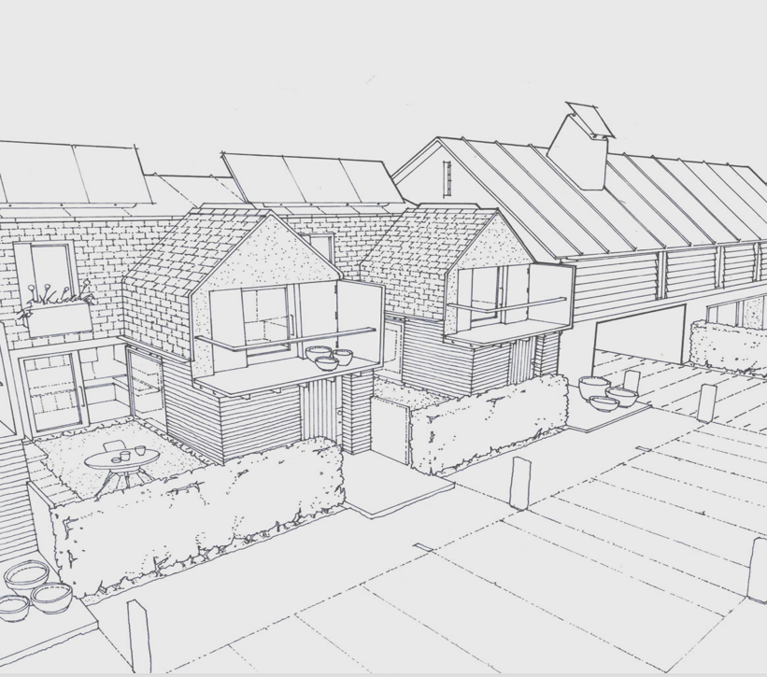
resilience
sketch study for a workspace & community hub with downsizer homes
Rural resilience consists of working with councils and local communities to deliver ‘rural hubs’ to address the issues around self-sufficiency faced by many rural settlements.
Rural hubs can be planned for a number of uses, but at its heart it is a small friendly shared workspace designed to provide a comfortable office environment for the increasing number of people who work from home. They can also provide a social focus as an amenity for the local community, providing shopping facilities and a space for local events.The land surrounding a rural hub could also potentially be integrated into an area’s GI network, or as a recreational area for the local community.
oneill homer #PlanningForGood

Slide 12
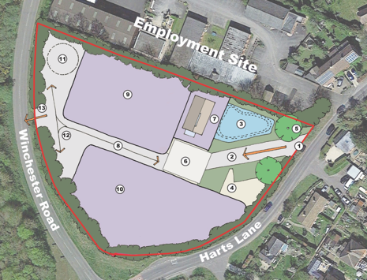
burghclere neighbourhood plan
The requirement for new homes in Burghclere had not yet been met, and although there is no requirement to allocate sites through a neighbourhood plan, the local community chose to do so to reflect the character, needs and opportunities of the area.
We worked with the local community through the process and assisted in writing policies for new homes addressing local need, new micro-business for the parish, as well as encouraging more working from home helping the parish to become more self-contained.
oneill homer #PlanningForGood

Slide 13
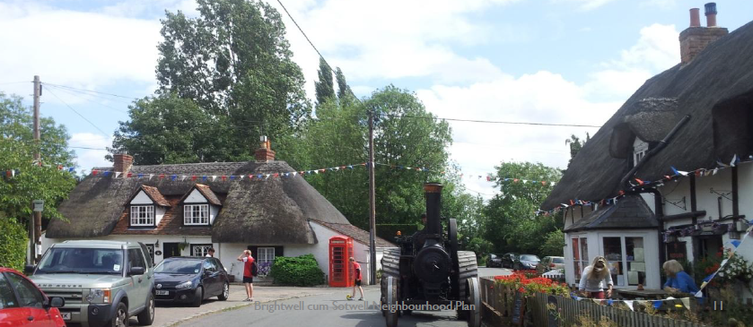
bRIGHTWELL CUM SOTWELL NEIGHBOURHOOD PLAN
The Parish Council wanted to address the threat of losing its precious village primary school and Post Office and shop and wanted to invest in its ‘Green Heart’ of local footpaths and public spaces running through the village. It used its neighbourhood plan to plan for new development to increase its resilience to these threats, and to defend against speculative development proposals in the wrong places.

Slide 14
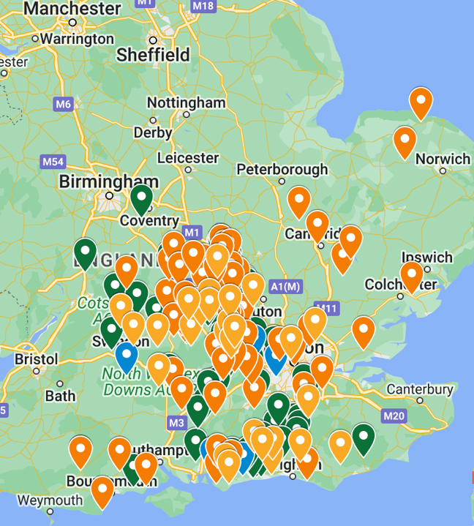
ONeill Homer planning for good
Merrsicourt, Chipping Norton, Oxfordshire
www.oneillhomer.co.uk
07833 462991
info@oneillhomer.co.uk

